Slide 1
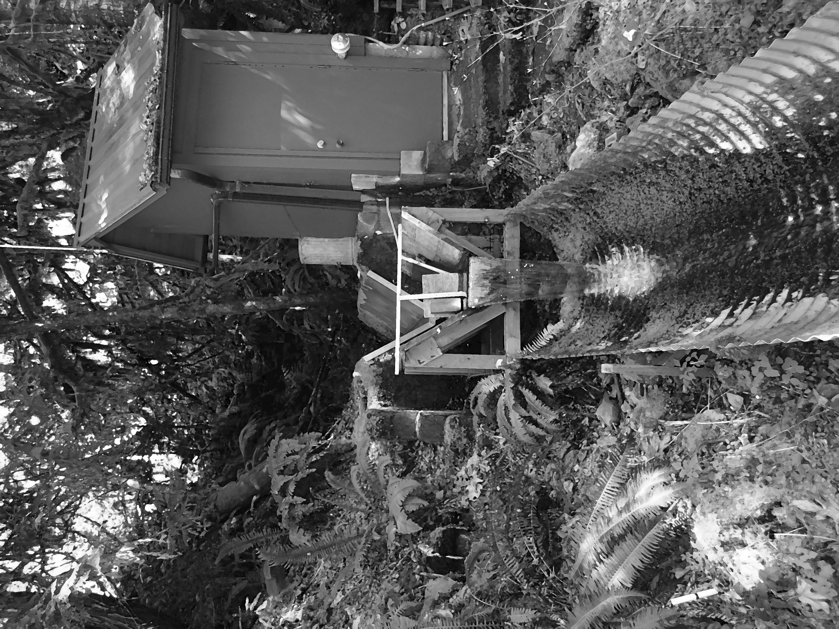
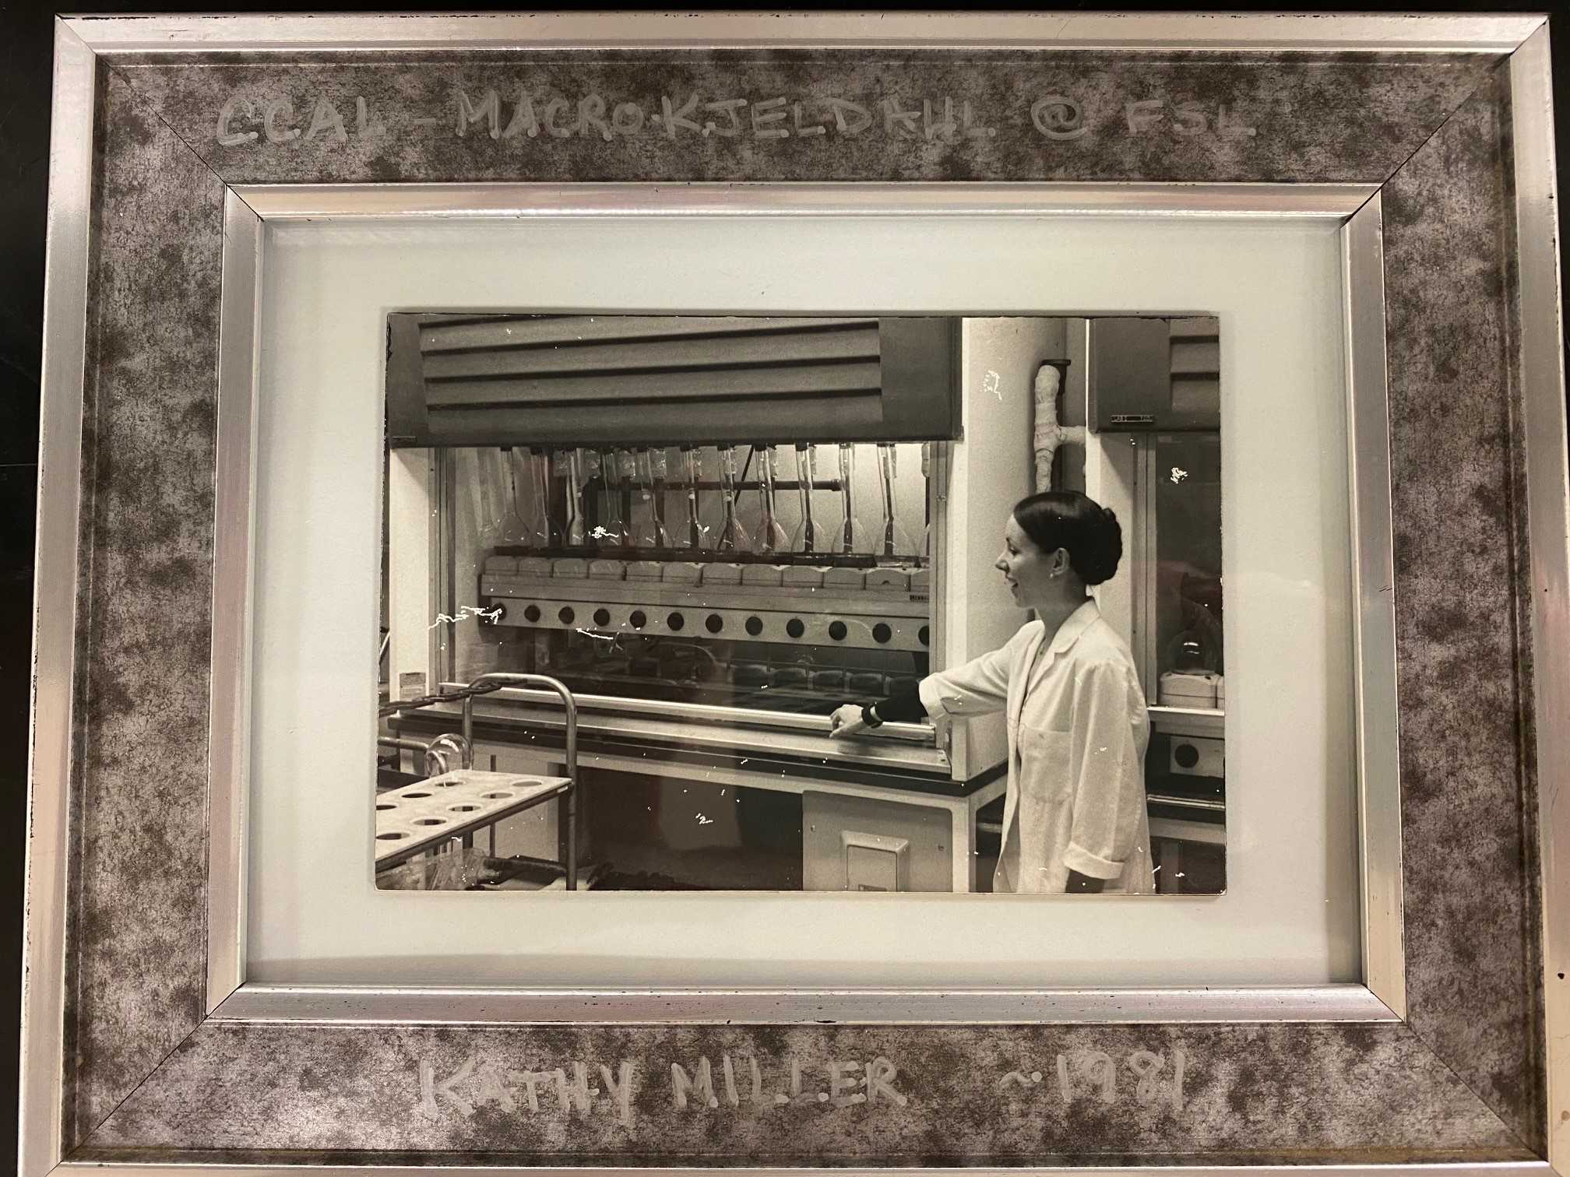
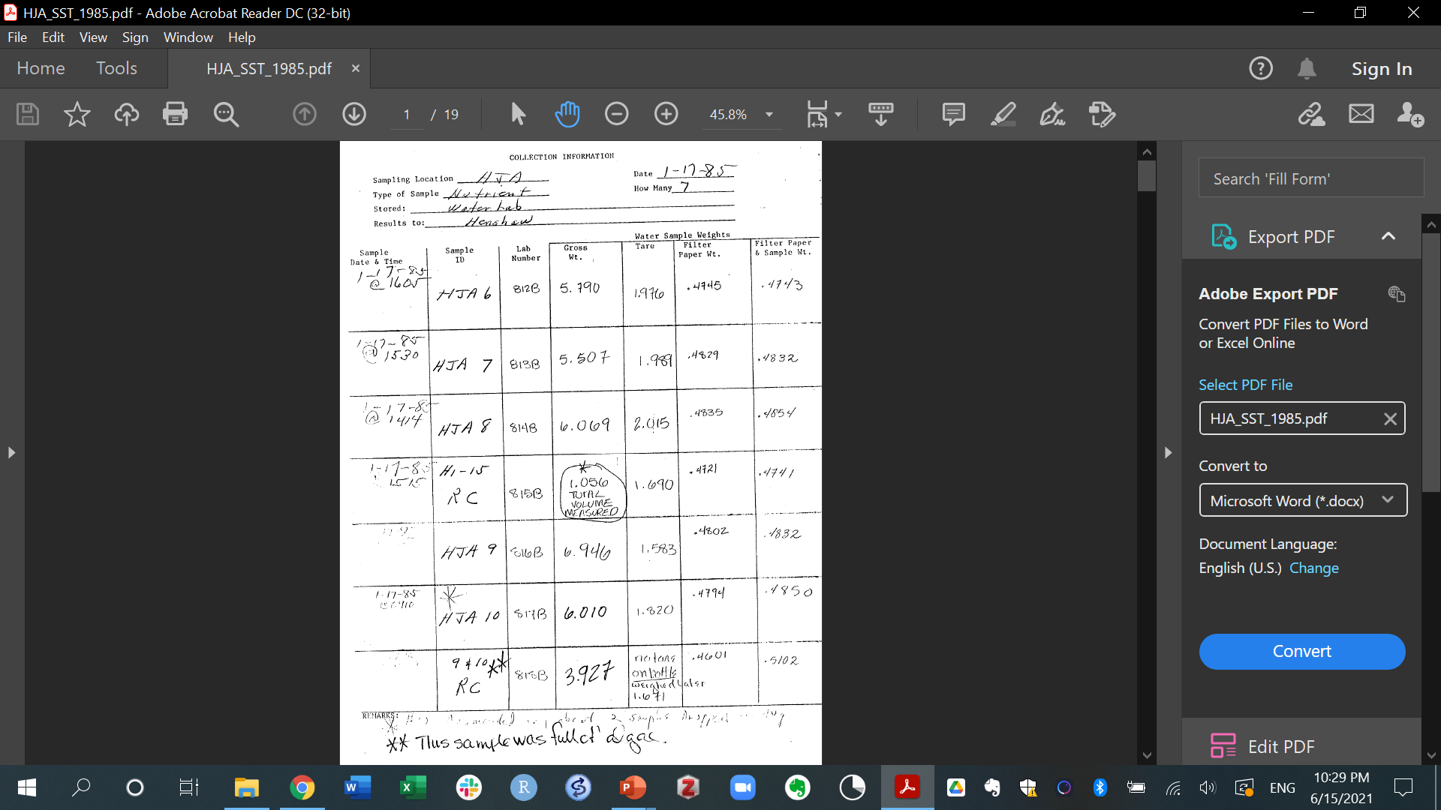
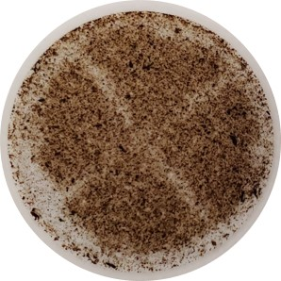
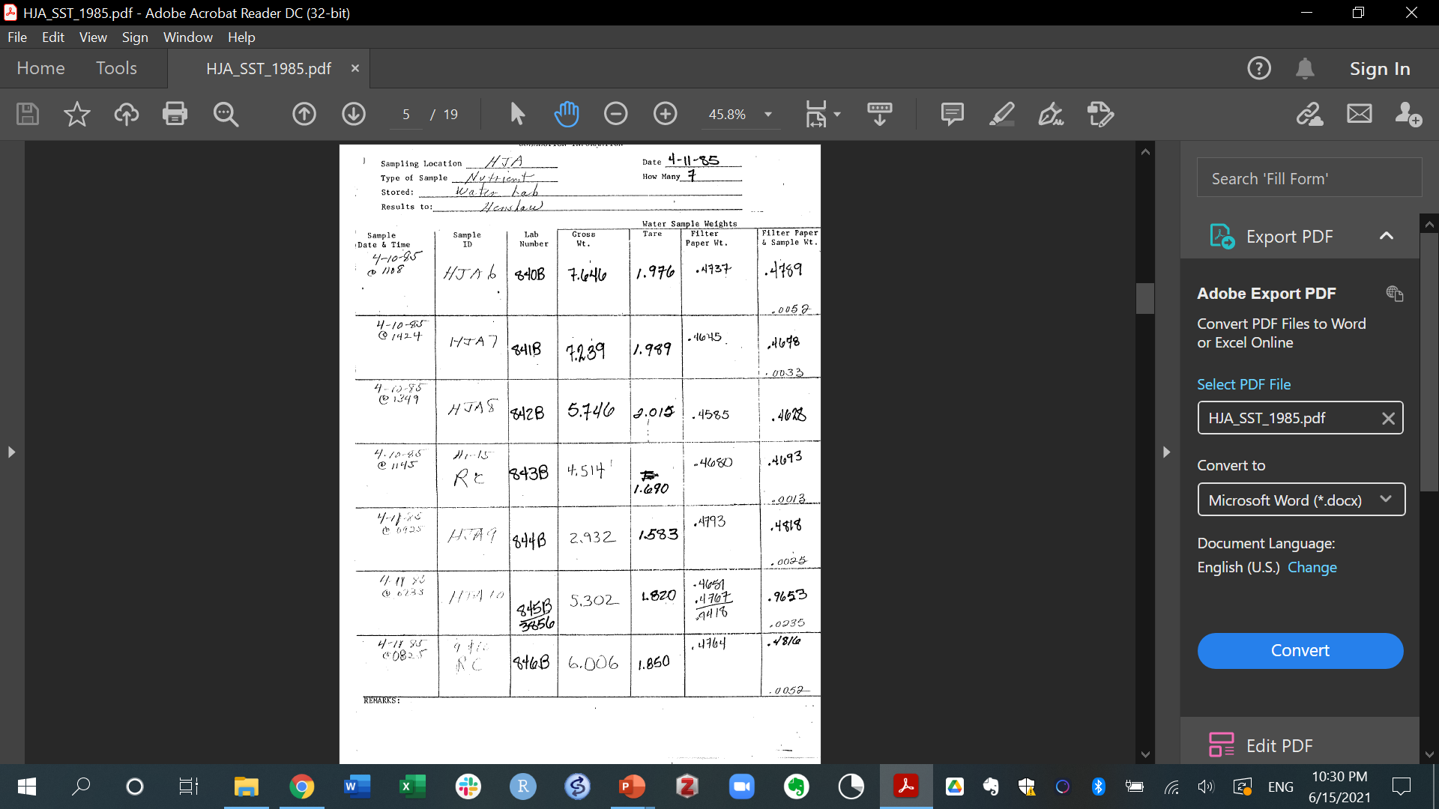
A well-preserved historical archive of filters with suspended sediments back to 1975
Our starting point for this project was a collection of filters
and paper archives containing primary data about the amount of water filtered and the mass of the sediments
retained in the filters.
Long-term ecological research
sites (LTERs) have been measuring water,
nutrient, and particulate fluxes for
several decades by using automatic
samplers.
Total suspended solids (TSS) is one of
the water quality variables measured
at these sites and the filters used to
measure TSS can be preserved for decades
under appropriate conditions.
Photo sources
We had to scan hundreds of pages and directly digitize the data to bring this information back to workable formats in the present.

Slide 2
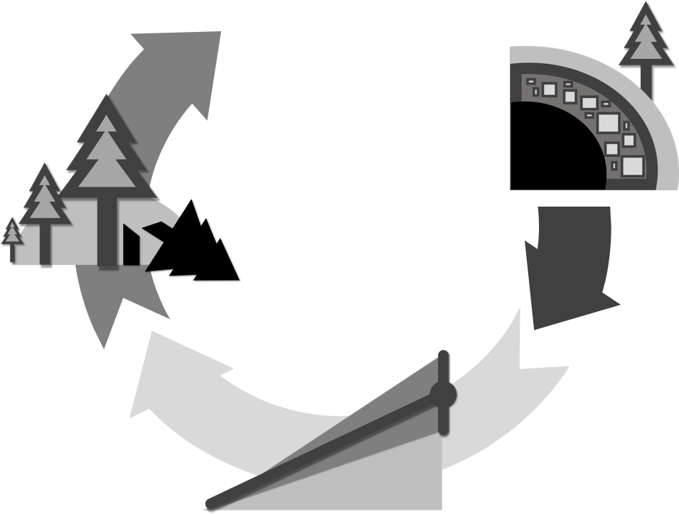
Long-term measurements of suspended solids have advanced our understanding
about sediment fluxes from headwaters
The most recent studies executed on experimental paired watersheds^{1,2,3} have examined the role of three main factors on controlling sediment fluxes:
Sediment
fluxes
Underlying
geology¹
Land-use
History^{2,3}
The types of rocks under the soil affect the amount of sediment that is supplied to the stream channels; watersheds with underlying resistant geology have lower sediment yields.
There is inconclusive evidence supporting the hypothesis that
changes in land management alone can increase sediment yields from headwater catchments.
Slope
variability²
Sites with more irregular surficial topography i.e., slope variability have higher sediment yields and more vulnerable to disturbances.
Notes:
With the aid of statistical models!

Slide 3
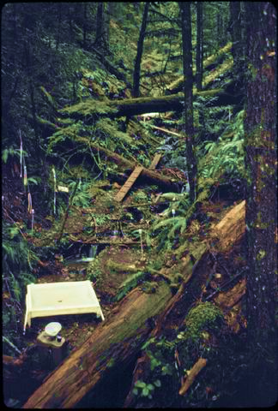
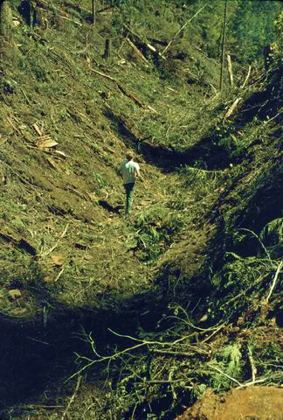
But important questions remain unanswered…particularly those about C fluxes!
Back in the 70’s when the paired watershed studies started most efforts were dedicated to nitrogen and phosphorus fluxes. Yet, C fluxes through these streams were being profoundly affected:
Where are the C sources?
This is
carbon!
This is
carbon!
This is
carbon!
This is
carbon!
This is
carbon!
Watershed 10 (WS10)
before clear-cut 1975
Watershed 10 (WS10)
after clear-cut 1975
Photo sources

Slide 4
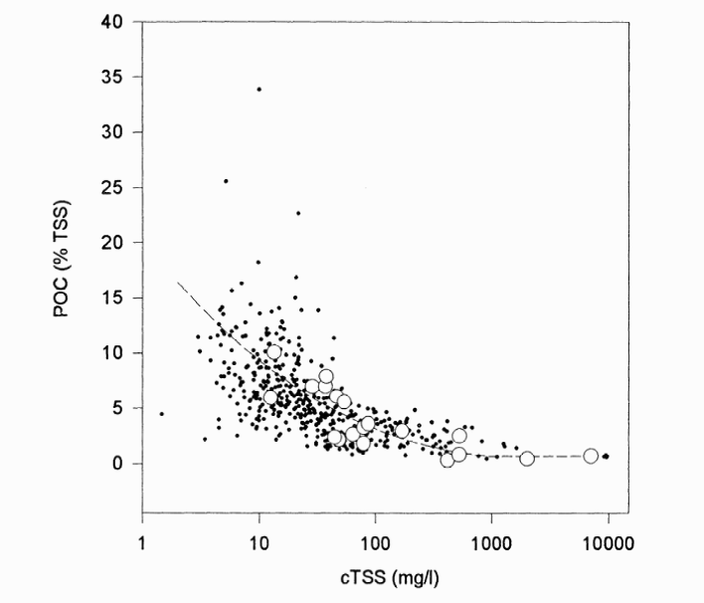
The movement of carbon in streams is strongly linked to the movement of sediments
The dominant view is that C fluxes are controlled by erosion and hence indirectly by other factors affecting the movement of sediments.
Less scatter for TSS<100 mg/l
Sediment
fluxes
Carbon
fluxes
Underlying
geology
Land-use
History
The dilution “model”⁴ originally based on a sample of 19 large rivers was formulated with an interesting caveat: “In spite of the large scatter, one can see that the POC% in the suspended solids generally decreases with increasing TSS concentrations.”
Slope
variability

Slide 5

In headwater catchments in the Oregon Cascades: 1) TSS is rarely > 100 mg/l 2) organic debris are both vertically and laterally added to the channel , and 3) the streams lack the power to mobilize all particulate inputs:
What controls the organic carbon content (%OC) in sediments exported from headwater streams in the Oregon Cascades?
?
%OC- Total Carbon
in sediments
Total Suspended Solids
(TSS) [mg/l]

Slide 6
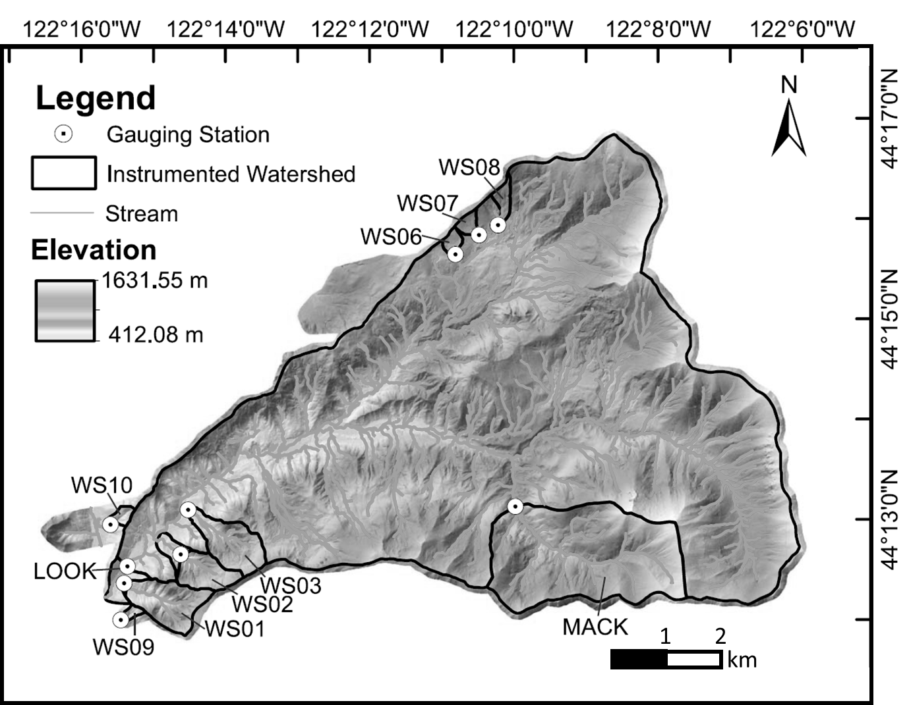
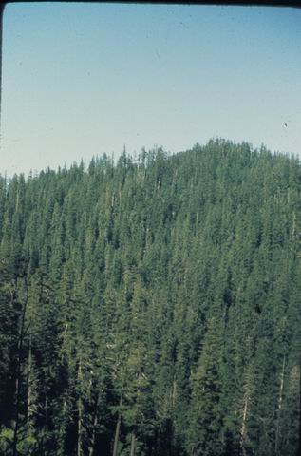
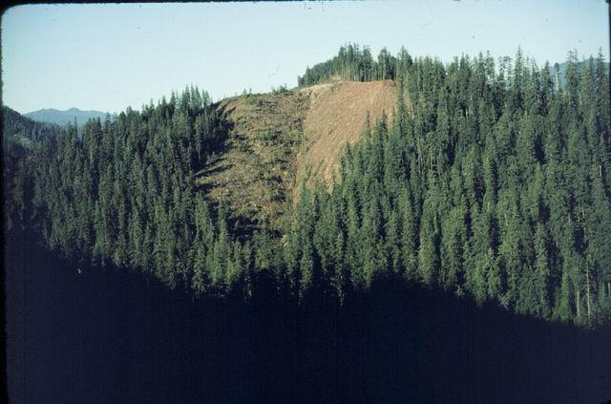
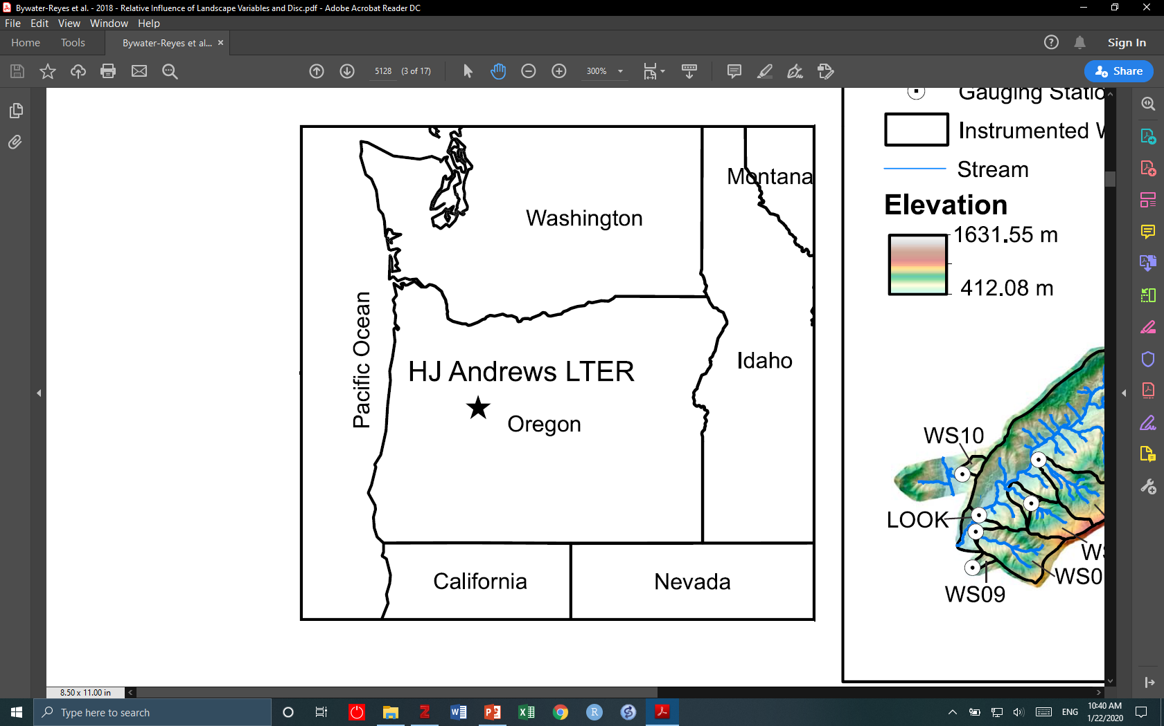
Our samples come from a paired-watershed study in the H. J. Andrews LTER in the
Oregon Cascades
Watershed 10 (WS10)
before clear-cut 1975
Watershed 10 (WS10)
after clear-cut 1975
In the summer of 1975, the 450+ year old forest on the steep slopes of the experimental Watershed 10 (WS10) was completely removed to study the impacts of logging on
sediment yield and nutrient fluxes (i.e., N, P). An adjacent watershed with similar elevation and underlying geology, Watershed 9 (WS09),was selected as a control watershed for this paired experiment.
The H. J. Andrews LTER sits in the
Oregon Cascades Mountains. There,
weathered volcanic rocks are the dominant
underlying geological feature. Lush forests
dominated by pines including Douglas-fir
(Pseudotsuga menziessi) cover most of the
landscape.
Source: Bywater-Reyes
et. al., 2018
Photo sources

Slide 7
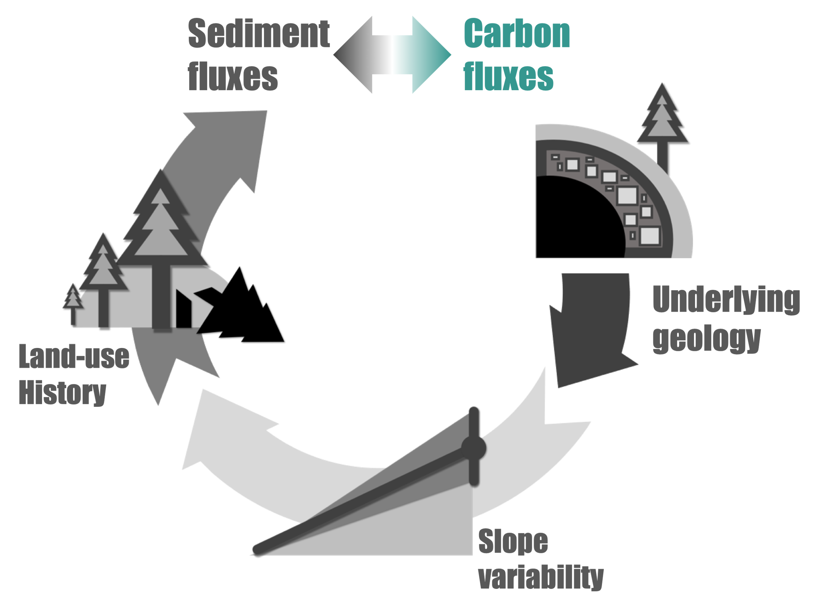
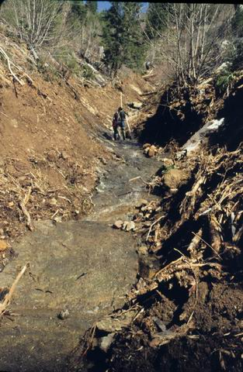


We adjusted our conceptual model to account for the particularities of our study sites
WS10
Logged in 1975
We compared Logged and Old-growth to include the paired nature of the original experiment.
WS09
Old-growth
450-year-old c.a. 1975
Underlying
geology
The underlying geology of both Watershed 10 (WS10) and Watershed 9 (WS09) was similar (i.e., weathered volcaniclastics)
Logged (WS10) after
Debris flow in 1986
Sediment
fluxes
Carbon
fluxes
We had to account for the role of a debris flow in Logged (WS10) and find a proxy for the recovery from that impact over time.
Disturbance
Impacts (?!)
Slope
variability
Additionally, the Logged (WS10) site has significantly higher slope variability than the Old-growth (WS09) site.
Land-use
History

Slide 8
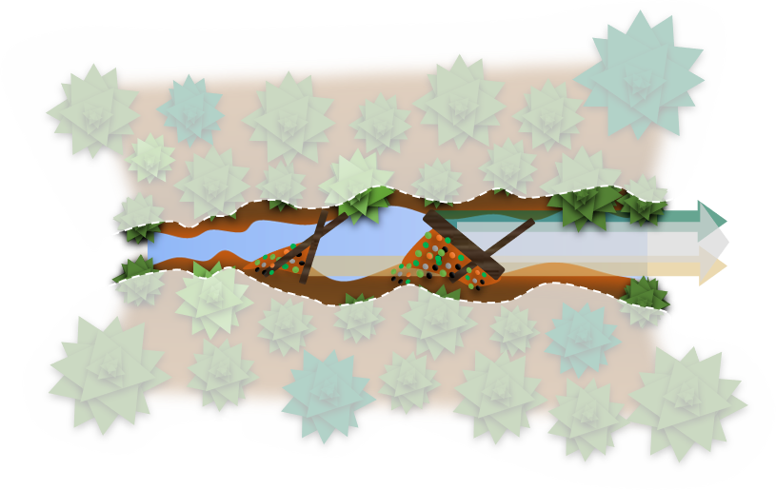
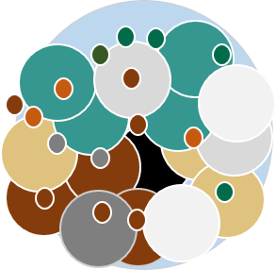

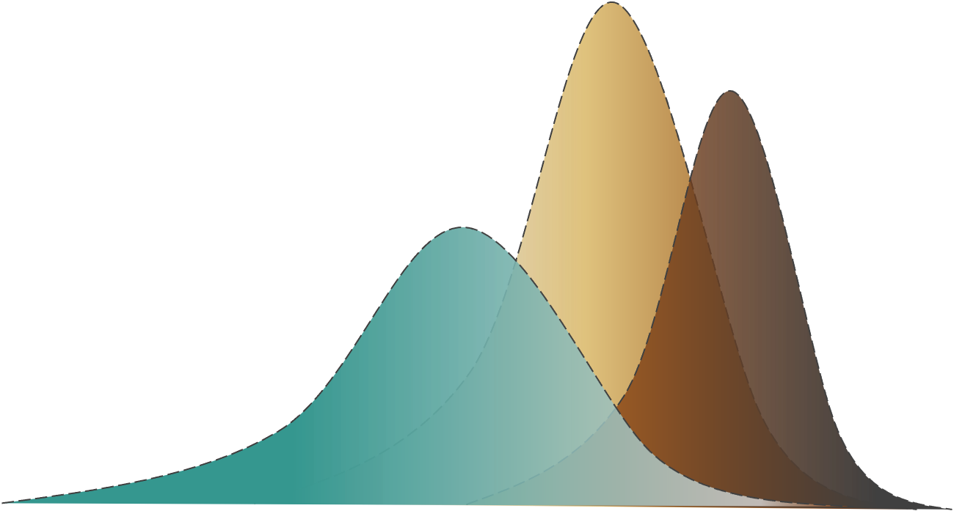
The heterogeneity of particle sources adds complexity to understanding what controls the organic carbon content of suspended sediments in headwaters
Source effects on the organic carbon content of stream sediments
Sediment
particles
Hillslope
Carbon Rich-Mineral Poor
(e.g., fresh litter inputs)
Stream
channel
Forest
floor
Mineral Rich-Carbon Poor
(e.g., mineral soil)
Deep
soil
Instream retention structures
(e.g., large woody debris)
Particle subpopulations
The superposition of organic particles from different sources and mobilized by different mechanisms (e.g., surficial erosion, vertical input, lateral input, etc.) suggests the existence of sediment particle subpopulations. These particle subpopulations may carry complex but subtle signals of watershed responses to disturbances and land use history.
Notes:
A complex but subtle signal.
Variety of particles, from a statistical point of view this is equivalent to the existence of different subpopulations of particles. But we cannot directly measure this from our filter samples, the amount of TSS we collect on those make more sophisticated chemical analyses complicated, even stable isotopes in some cases.
I included the white “veil” to emphasize that the method does not implies deconvolution of the subpopulations but emphasize multimodality with the built-in assumption that the overall distribution may represent the superposition of different subpopulations.

Slide 9

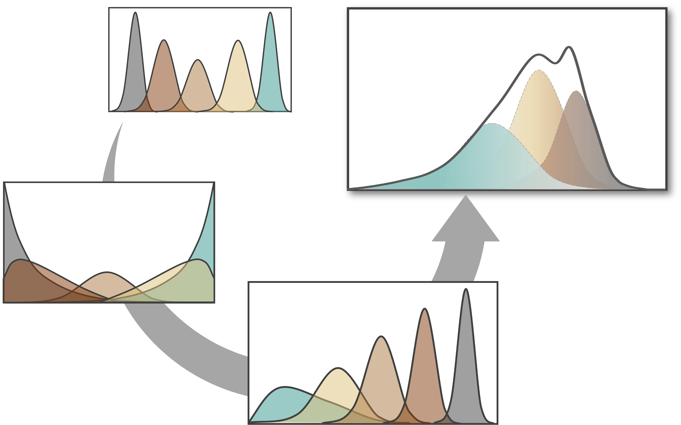
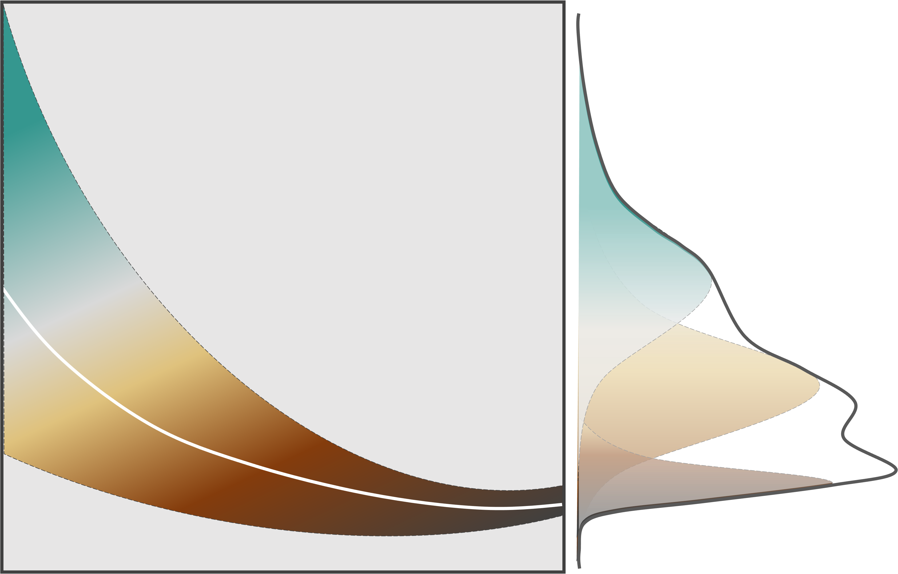
We used the novel Beta Regression with Variable Dispersion to model the distribution
of organic carbon content in stream sediments
Statistically speaking, we want to be able to predict changes in the marginal distribution of the carbon content of suspended sediments while assuming the existence of particle subpopulations.
Beta Regression with Variable Dispersion for continuous variables in [0,1]
Changing mean with
(small) and constant dispersion
The “dilution model” does not make
a clear distinction between transport effects (i.e., due to discharge and TSS) and source effects (i.e., due to the variety of sources of organic carbon to the channel).
Changing mean with
(large) and constant dispersion
%OC- Total Carbon
in sediments
Changing mean with
variable dispersion
Such a goal can be achieved via beta regression models with variable dispersion⁵ which, theoretically allow for the effects that the existence of particle subpopulations could have on the overall distribution of the response variable.
Total Suspended Solids
(TSS) [mg/l]
Transport effects
Source effects
Marginal distributions (envelope)
As a function of discharge (Q)
and Total Suspended Solids (TSS)
As a function of Dissolved Silica (proxy for soil disturbance) and Dissolved
Organic Nitrogen (proxy for effects of land use history)
Notes:
I included the white “veil” to emphasize that the method does not implies deconvolution of the subpopulations but emphasize multimodality with the built-in assumption that the overall distribution may represent the superposition of different subpopulations.

Slide 10
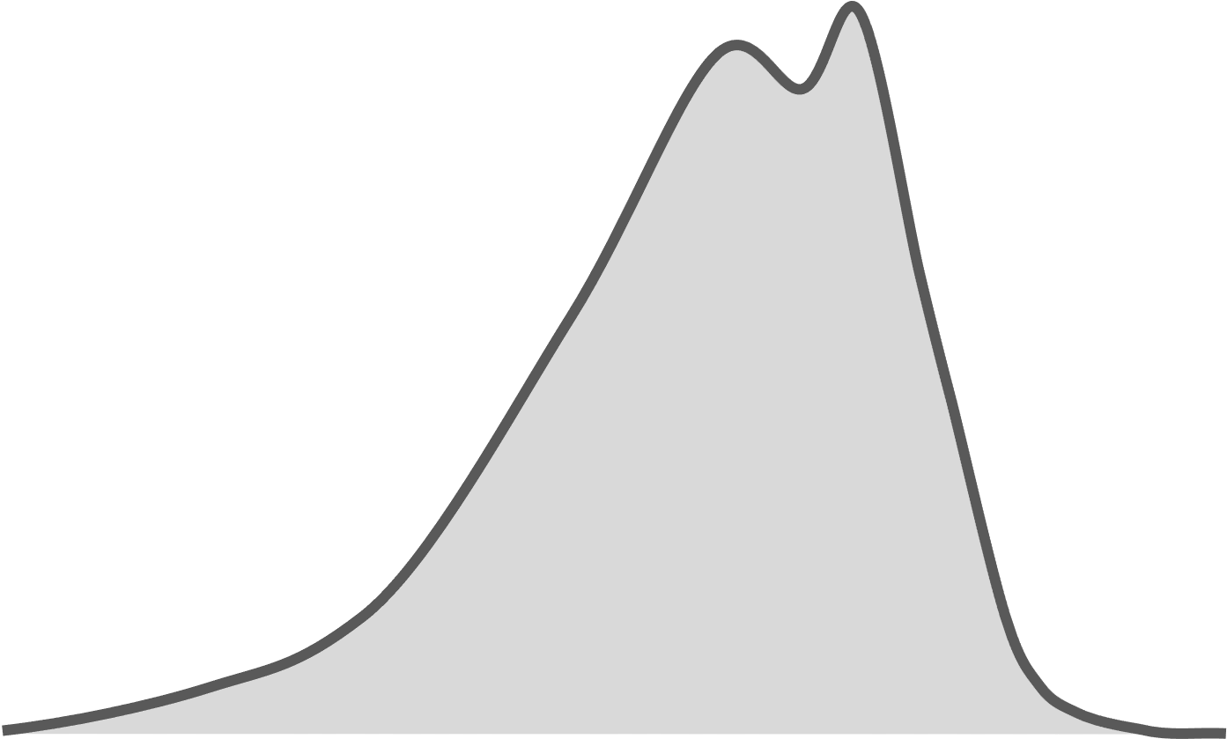

Slide 15
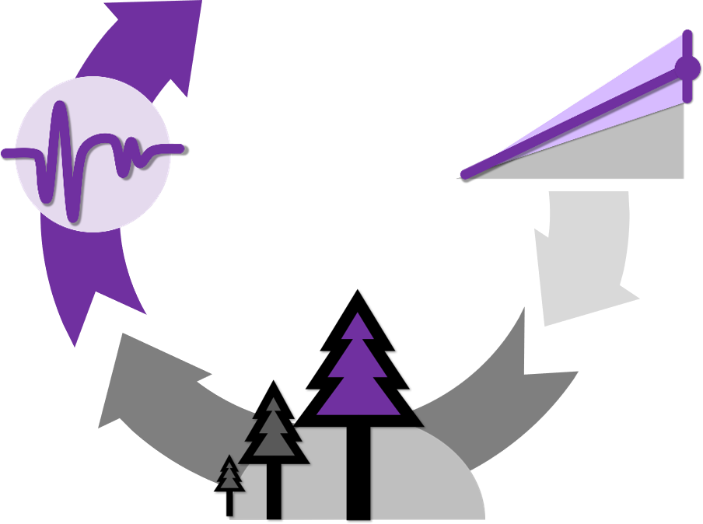
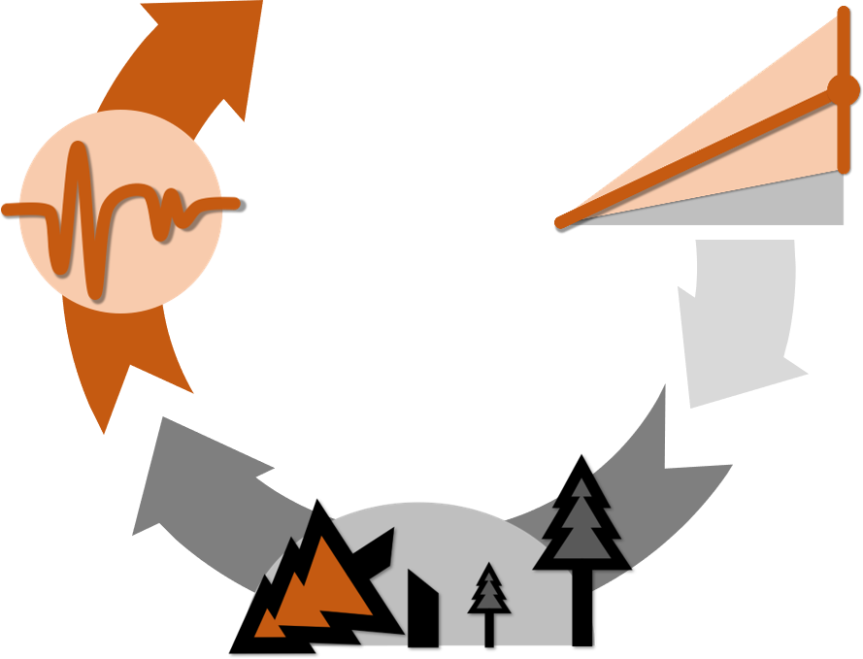
We adjusted our conceptual model to account for the particularities of our study sites
Watershed 10 (WS10)
Logged
clear-cut 1975
Watershed 9 (WS09)
Control
450-year-old c.a. 1975
We compared Watershed 10 (WS10) and Watershed 9 (WS09) to include the paired nature of the original experiment.
Watershed 10 (WS10) after
Debris flow in 1986
We had to account for the role of a debris flow in Watershed 10 (WS10) and find a proxy for the recovery from that impact over time.
The underlying geology of both Watershed 10 (WS10) and Watershed 9 (WS09) was similar (i.e., weathered volcaniclastics)

Slide 16
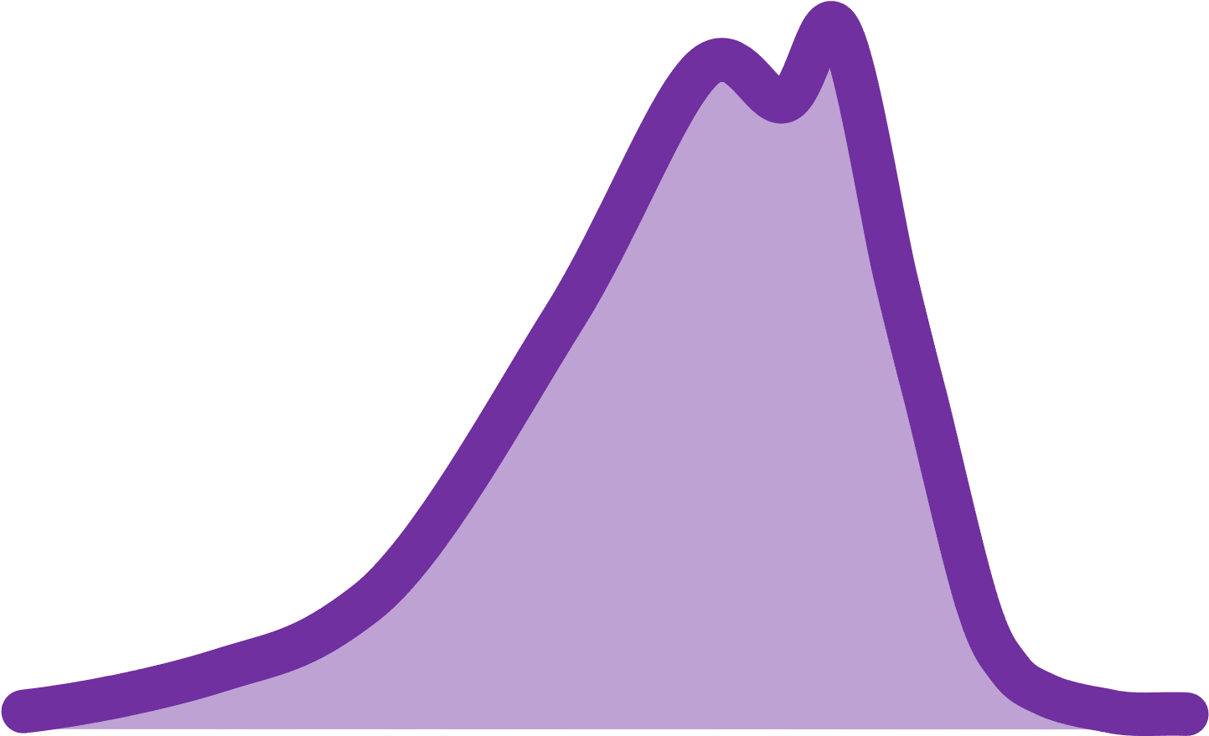
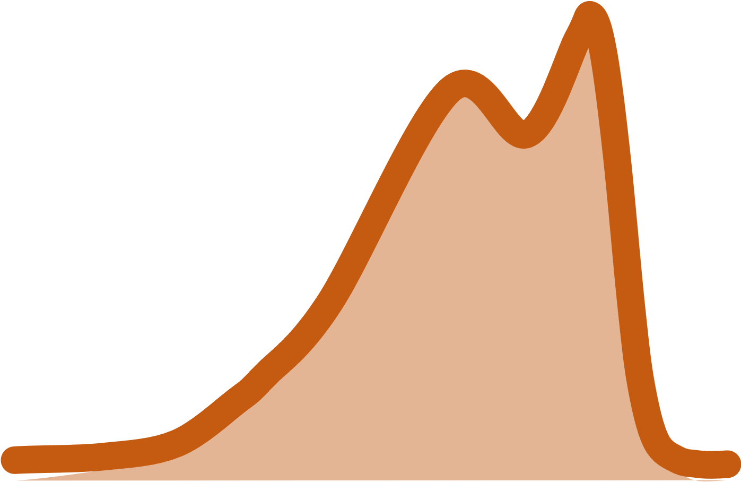

Slide 17
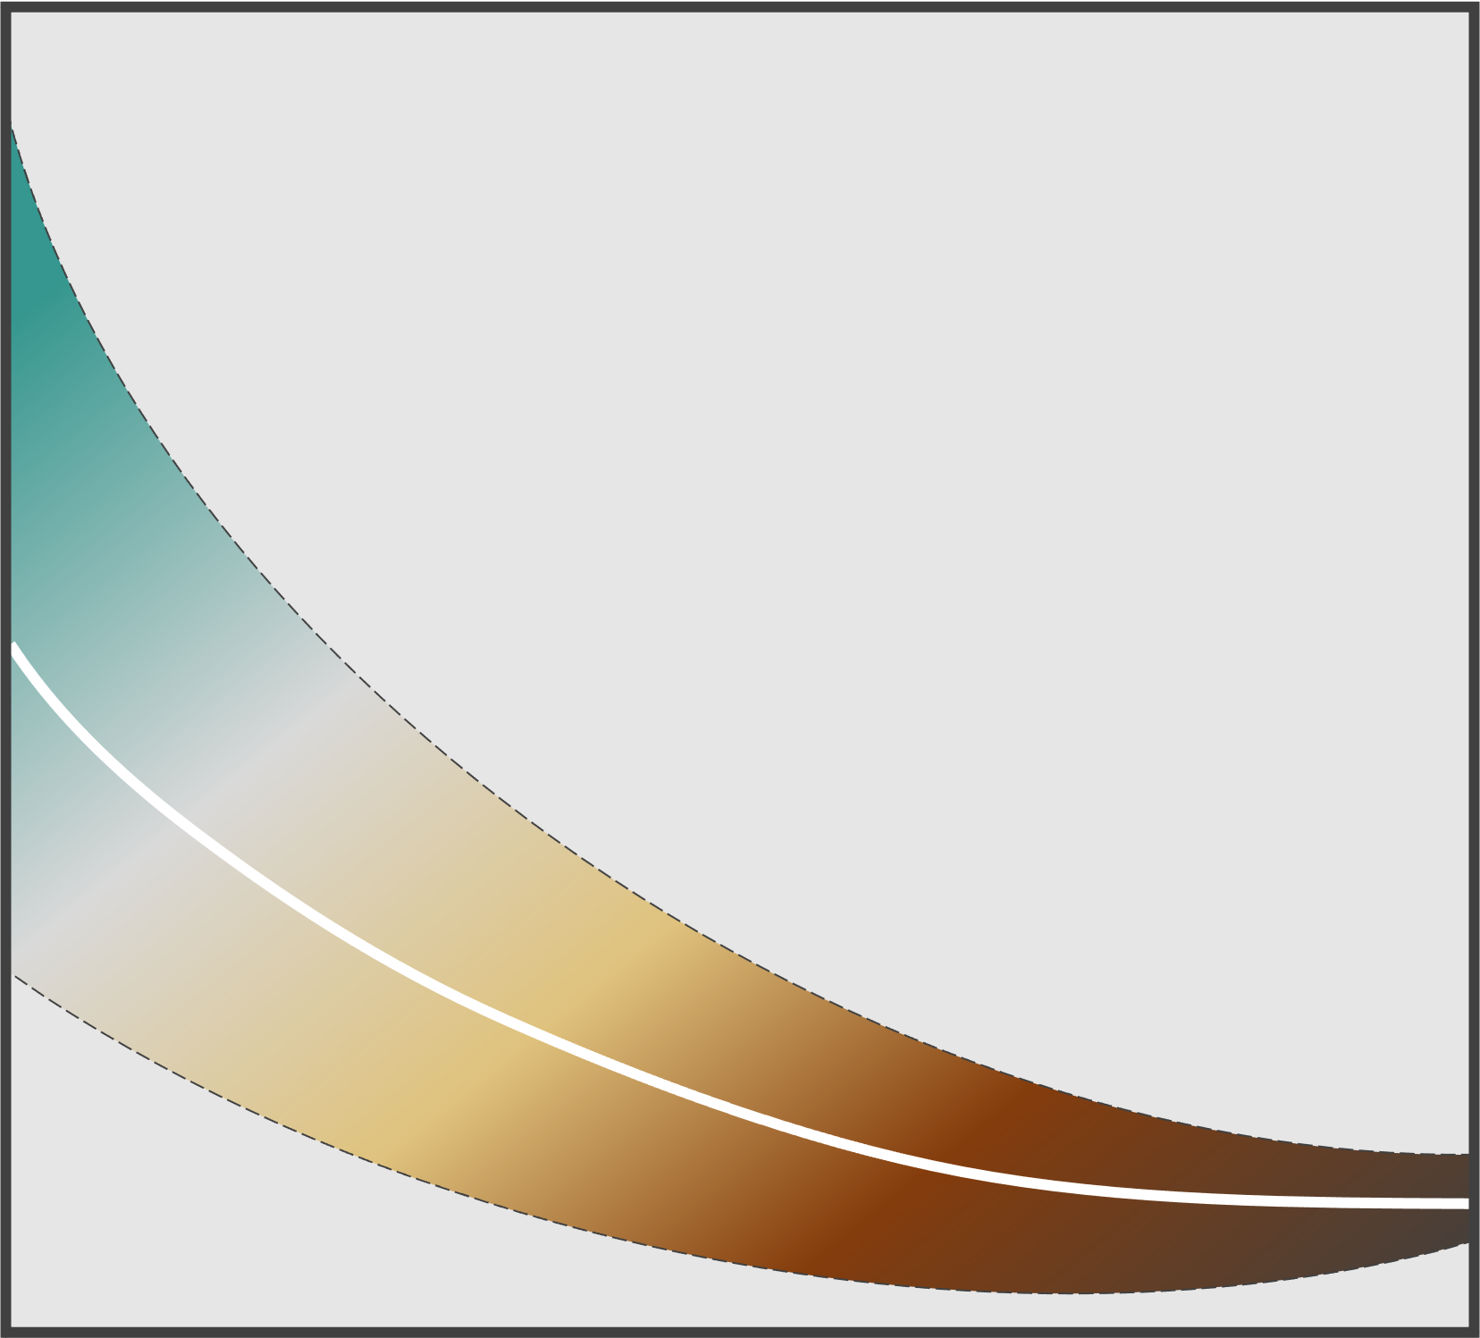

Slide 18
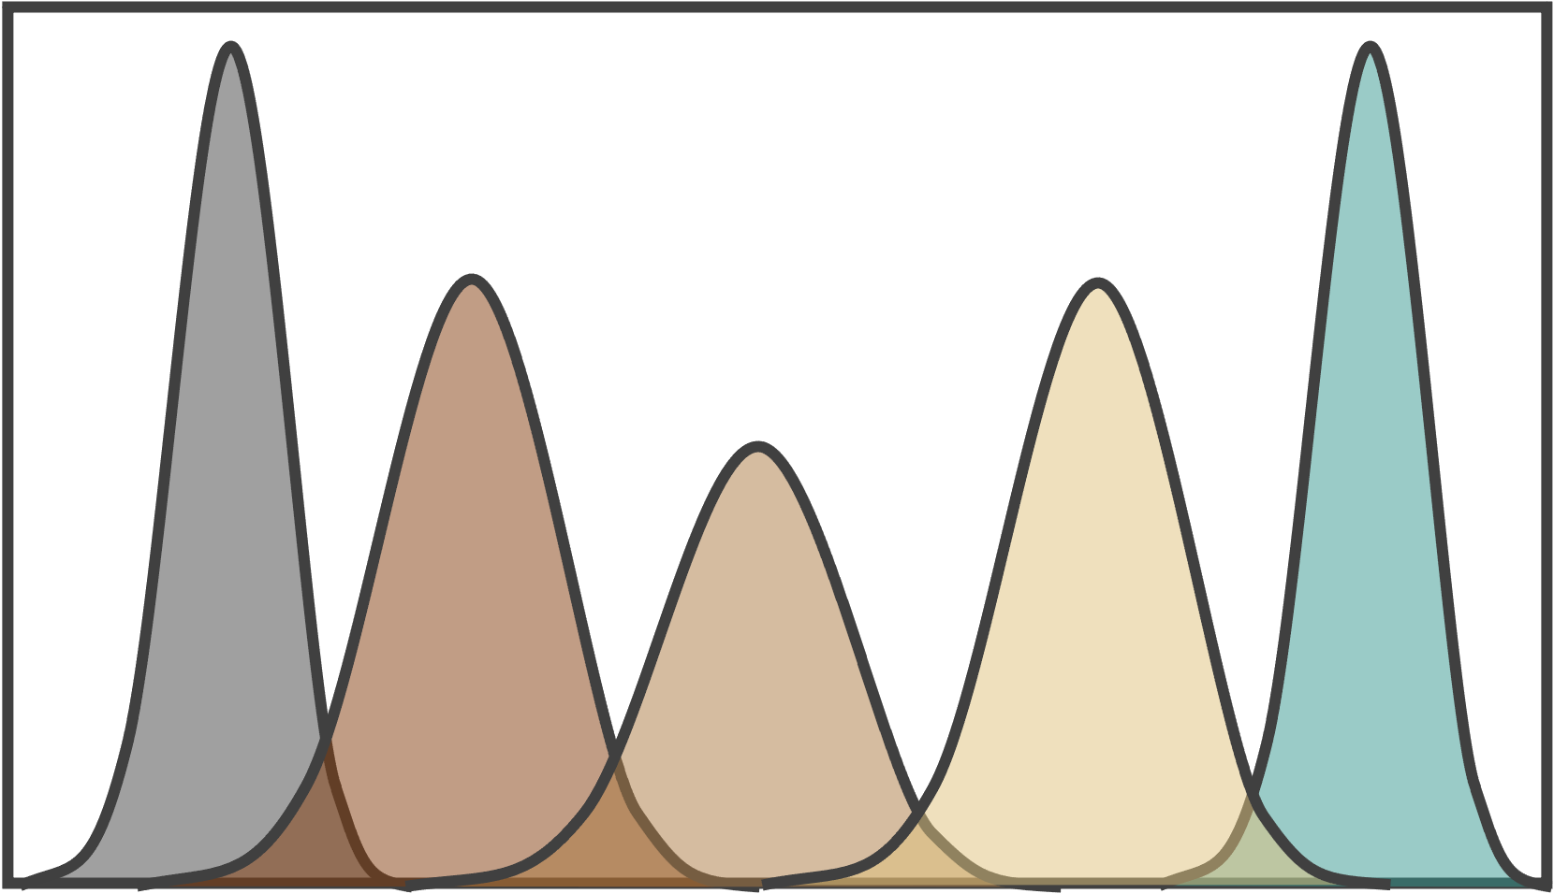
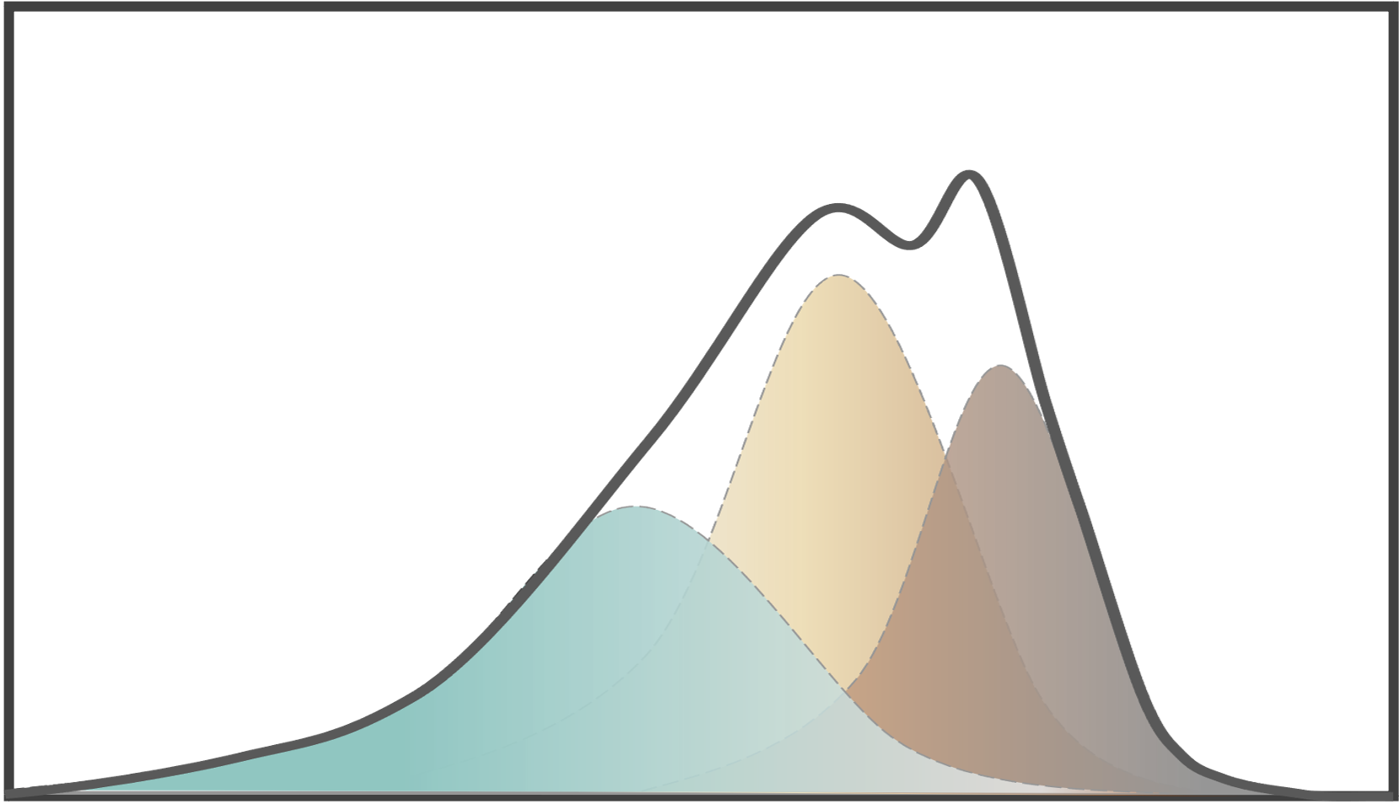
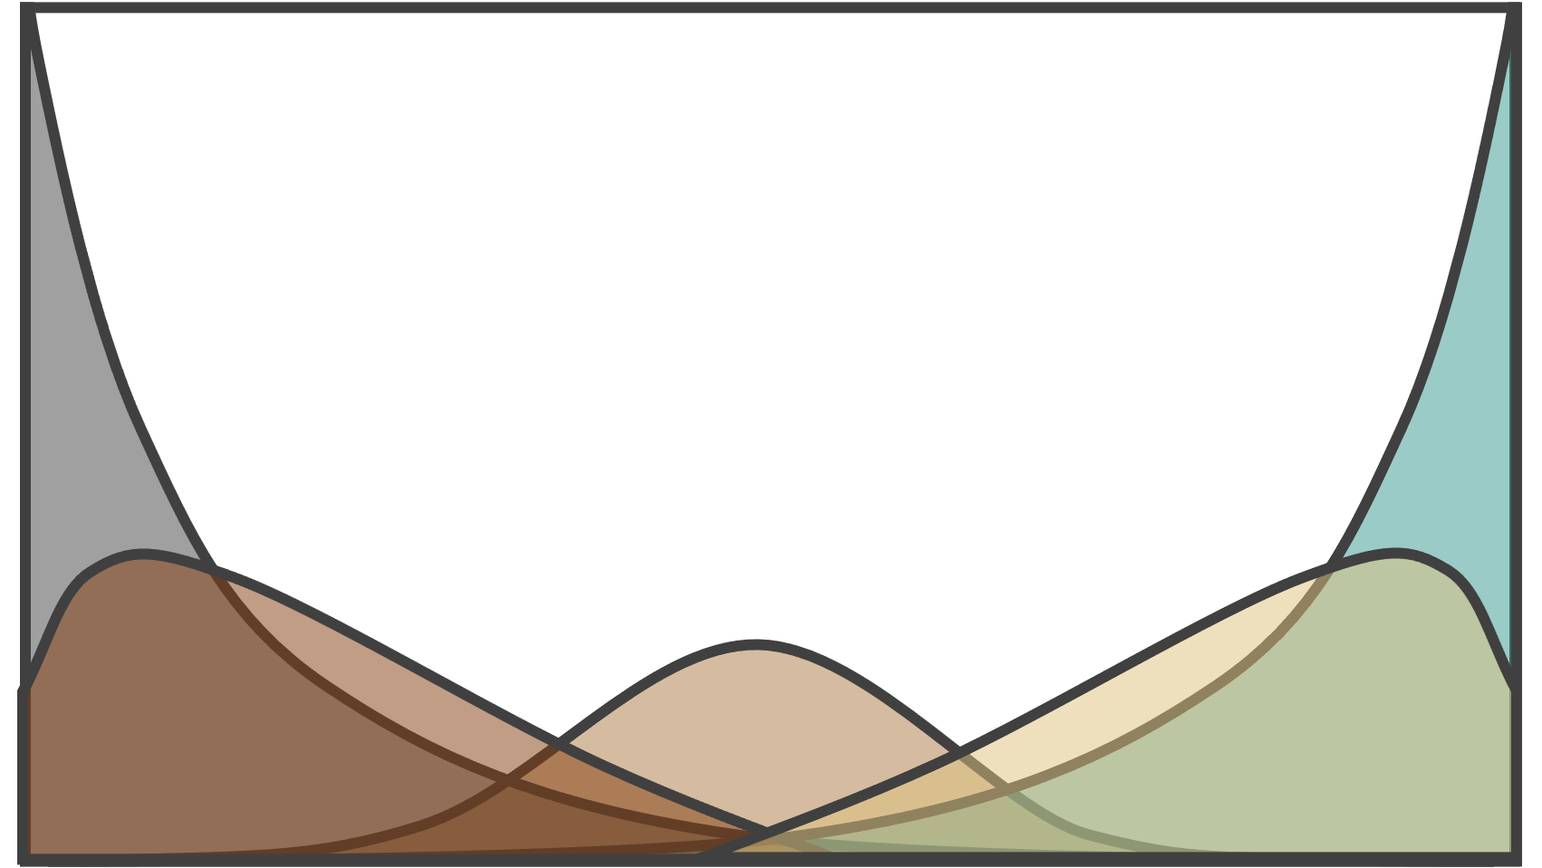
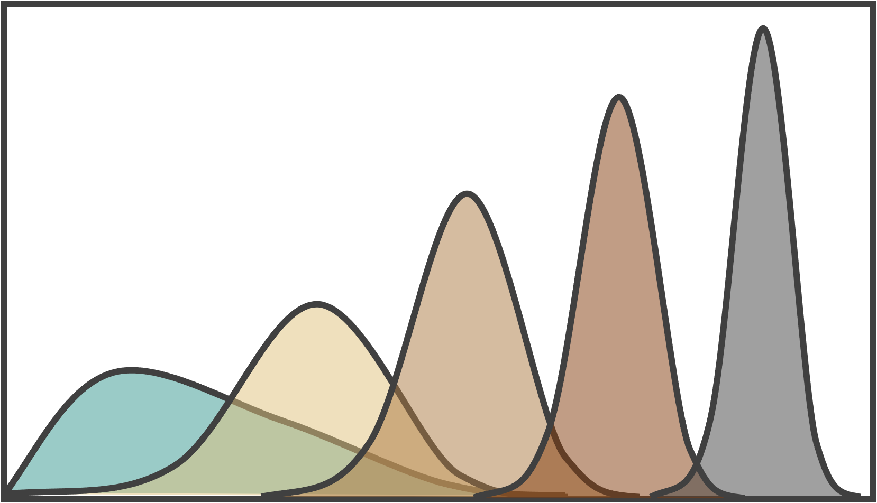

Slide 23
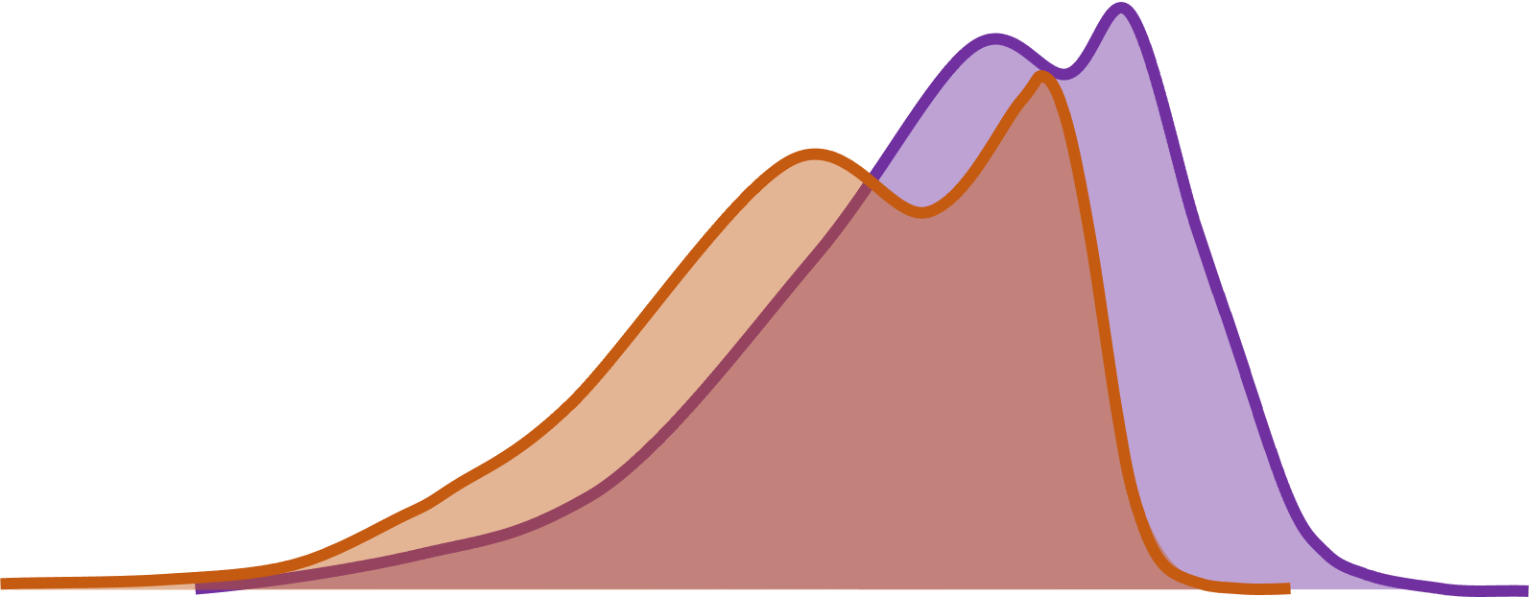
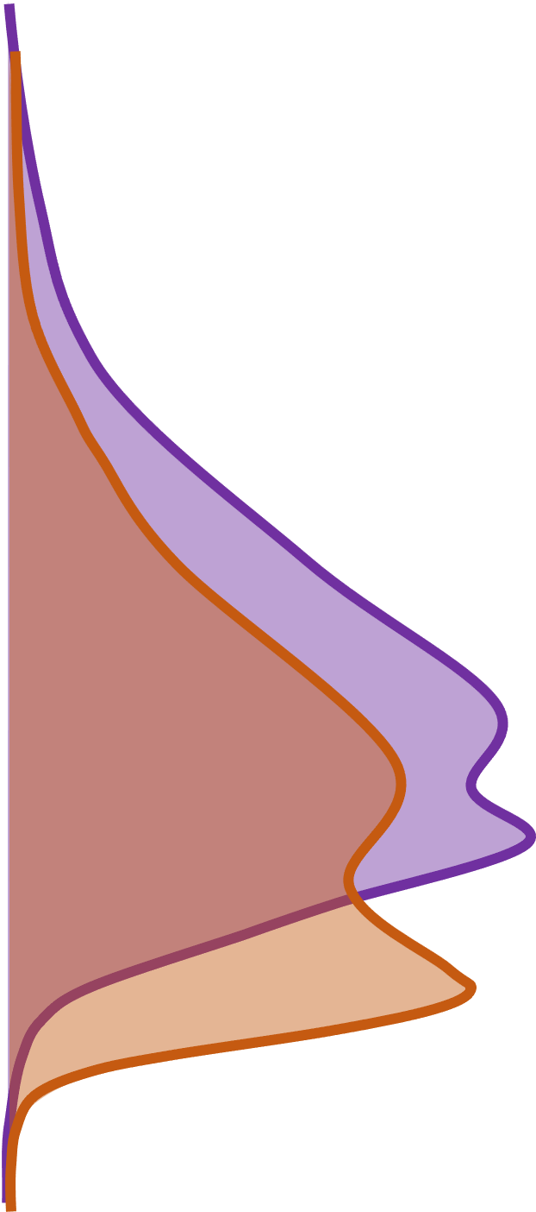
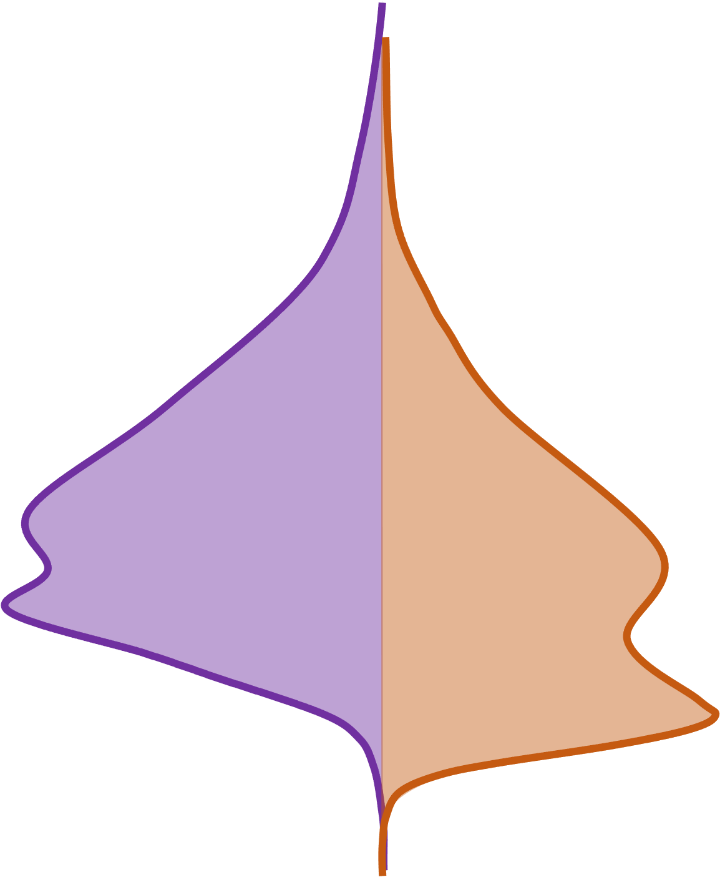

Slide 24
Notes:
I included the white “veil” to emphasize that the method does not implies deconvolution of the subpopulations but emphasize multimodality with the built-in assumption that the overall distribution may represent the superposition of different subpopulations.

Slide 25
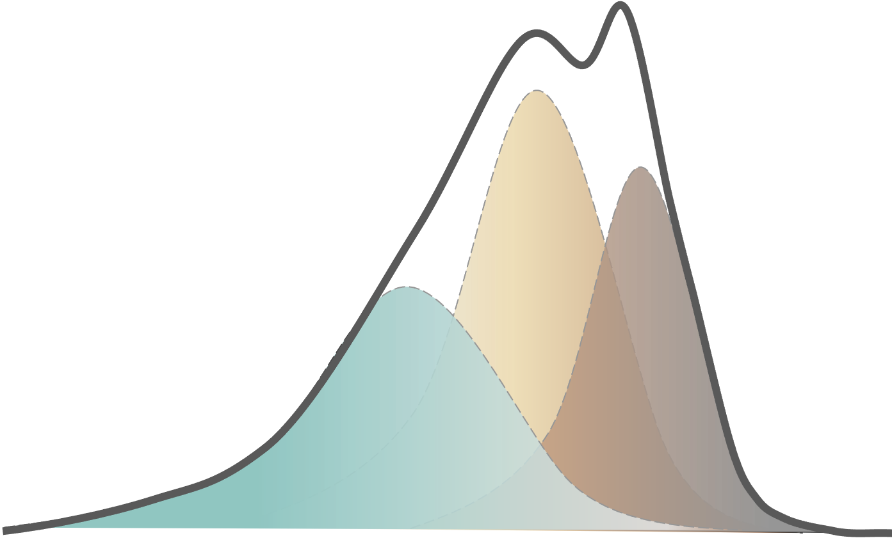
% Organic
Carbon
Probability
density
Notes:
I included the white “veil” to emphasize that the method does not implies deconvolution of the subpopulations but emphasize multimodality with the built-in assumption that the overall distribution may represent the superposition of different subpopulations.

Slide 26

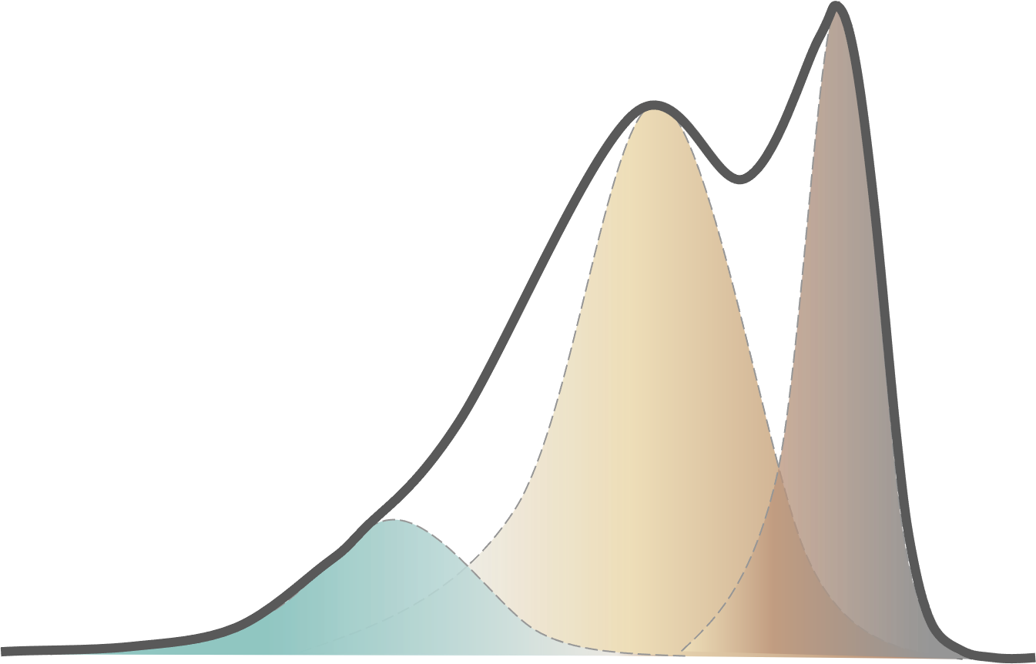

Slide 27
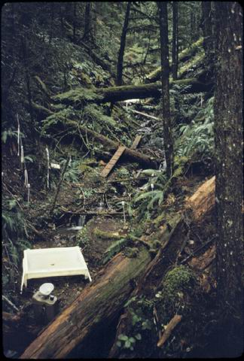
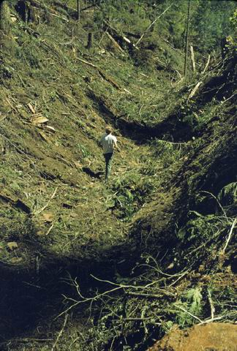

Slide 28
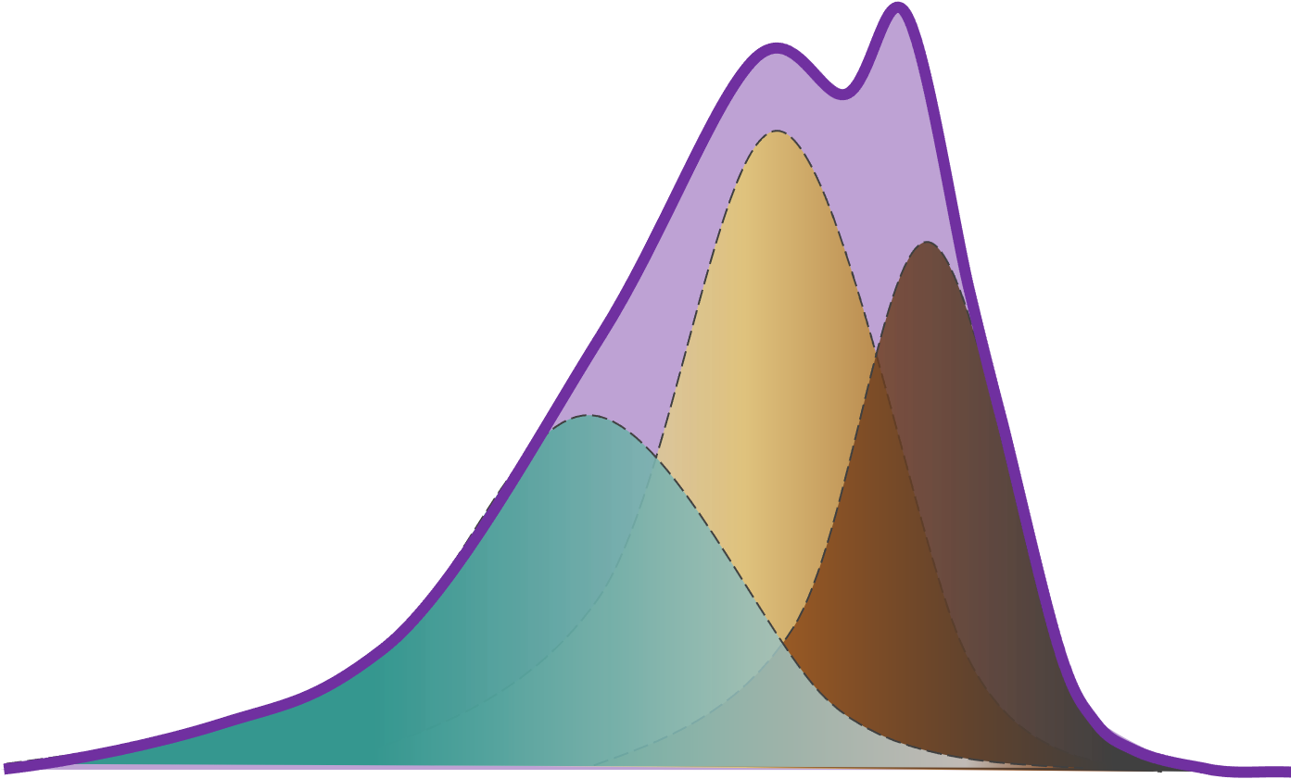
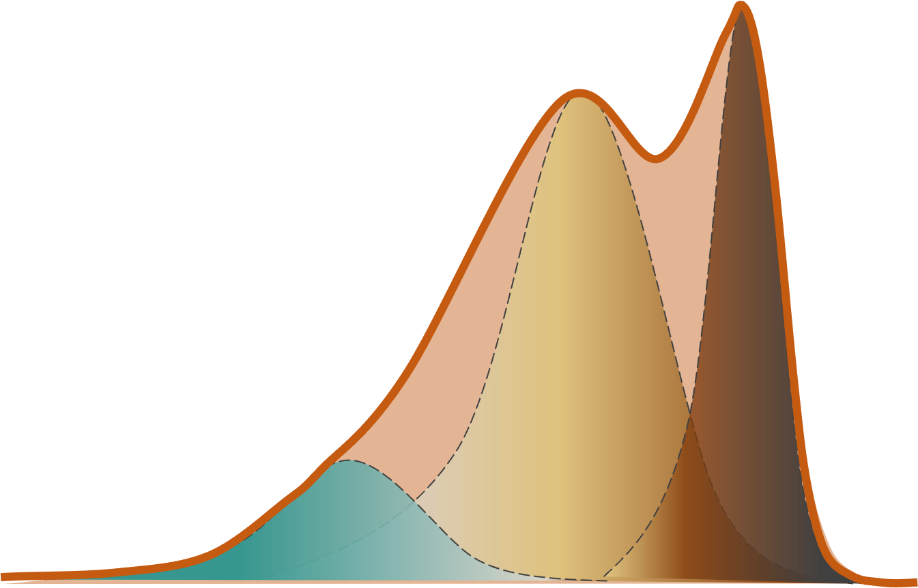

Slide 29
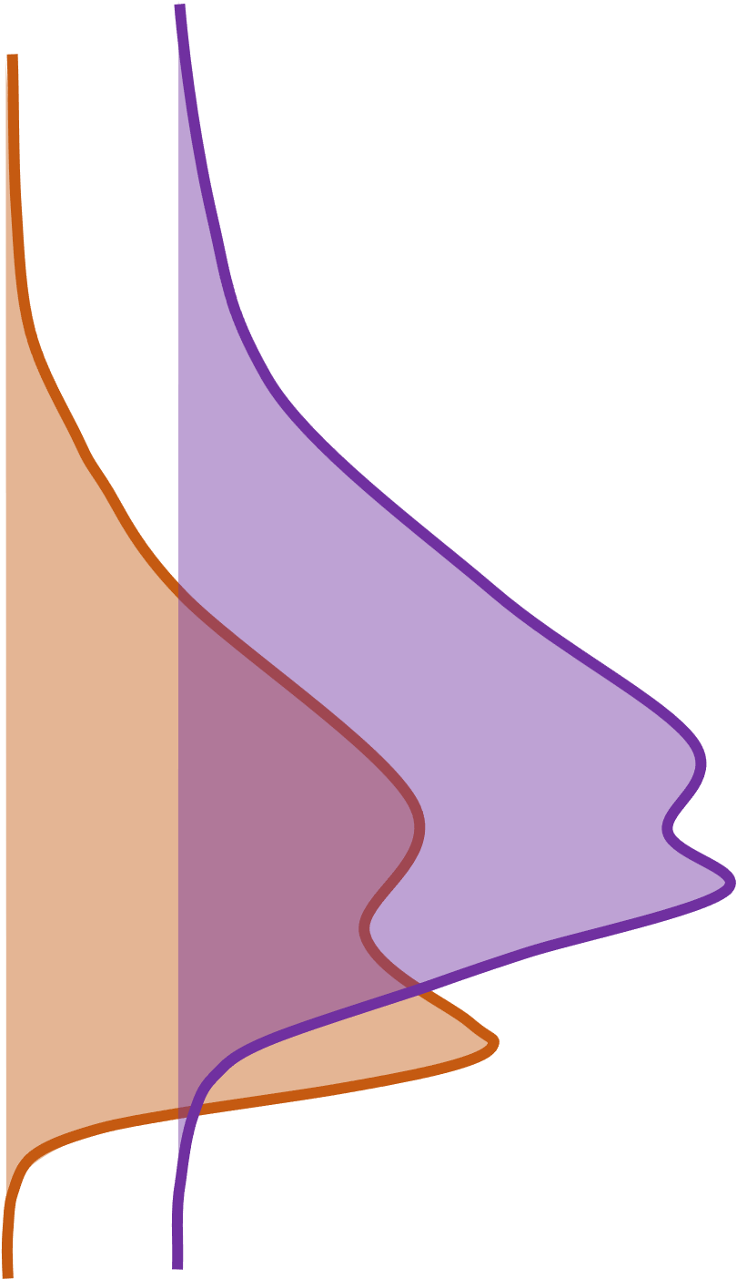
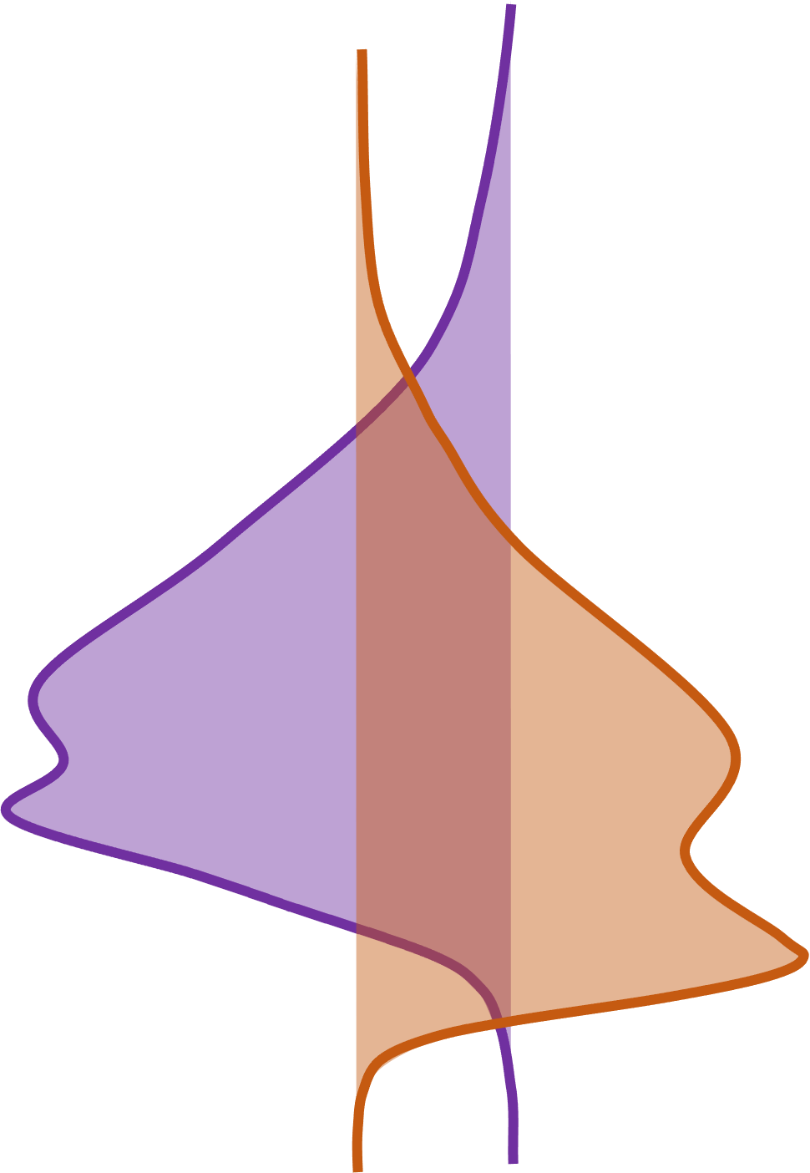

Slide 30
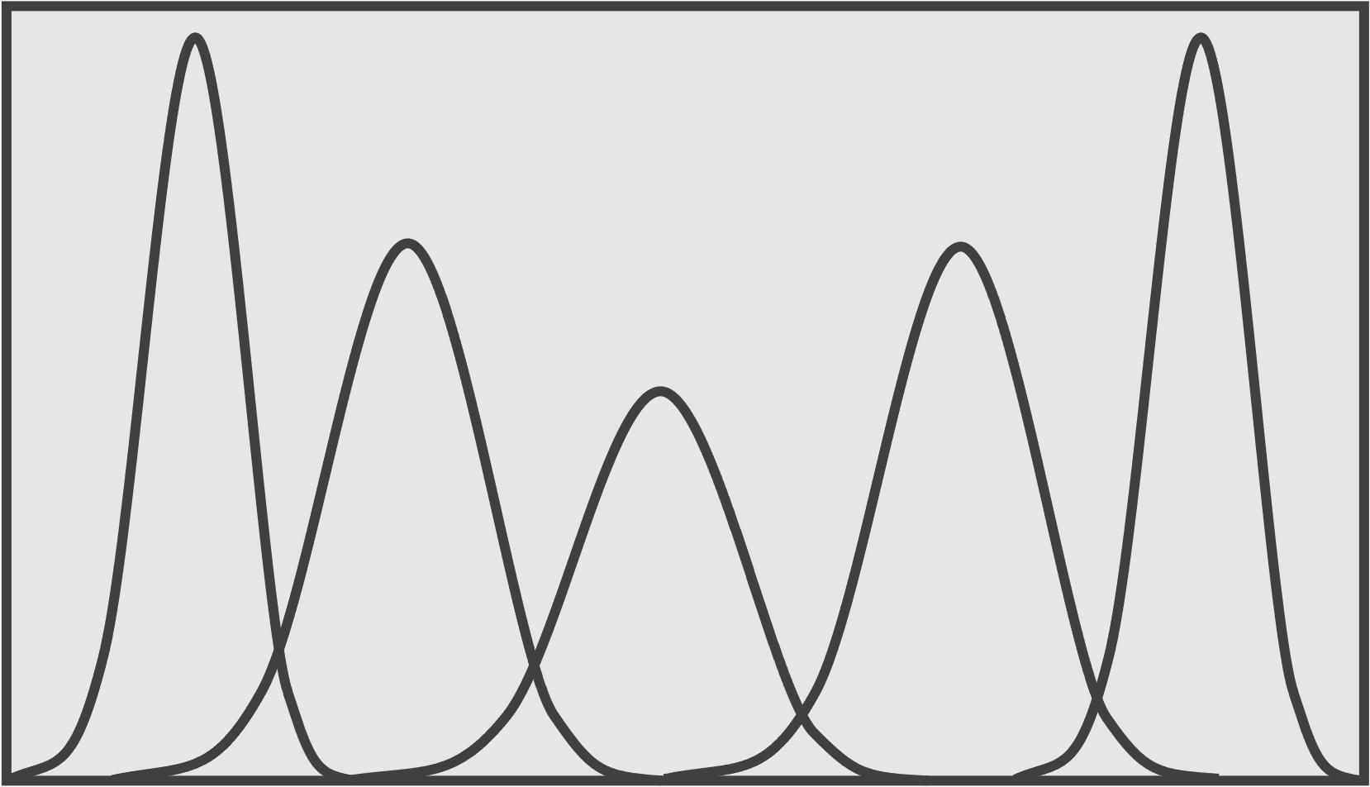
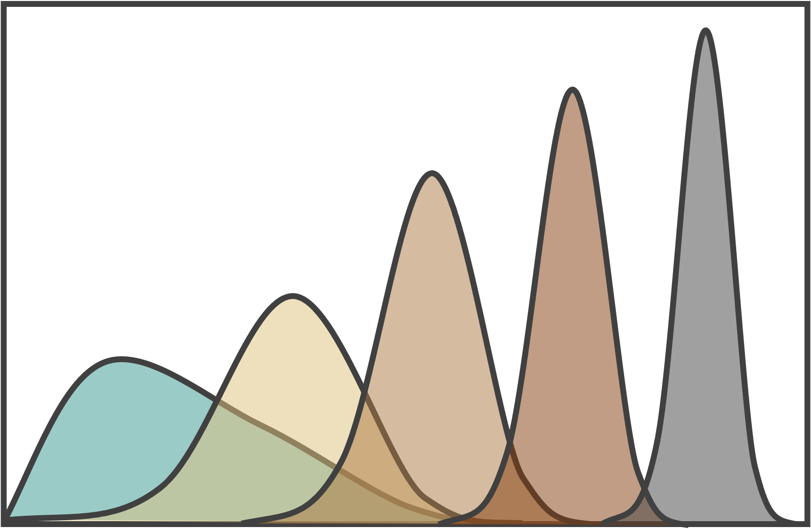
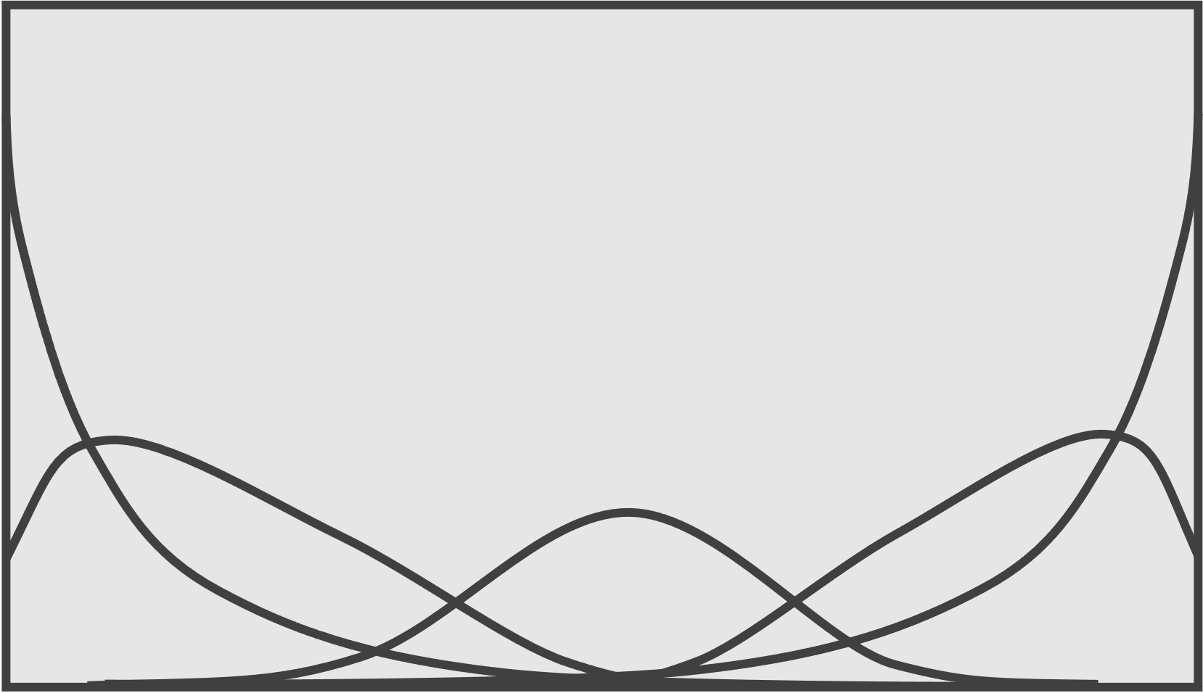

Slide 31
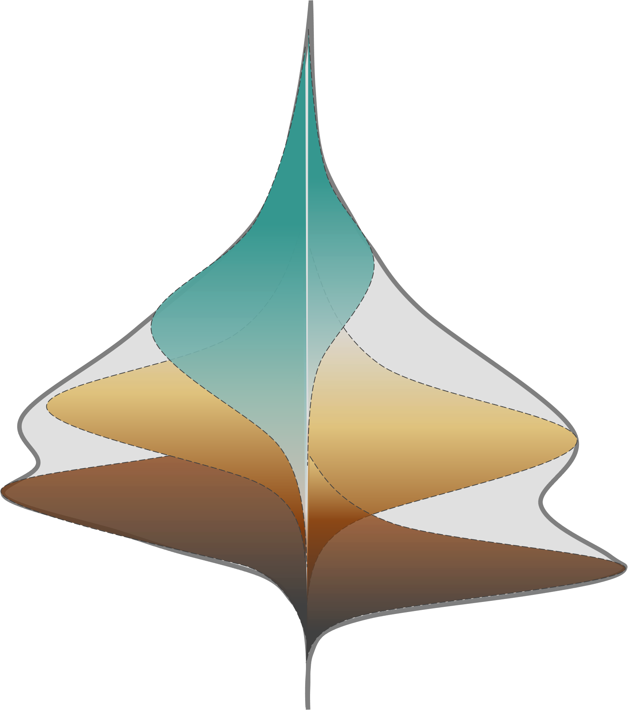


Slide 32
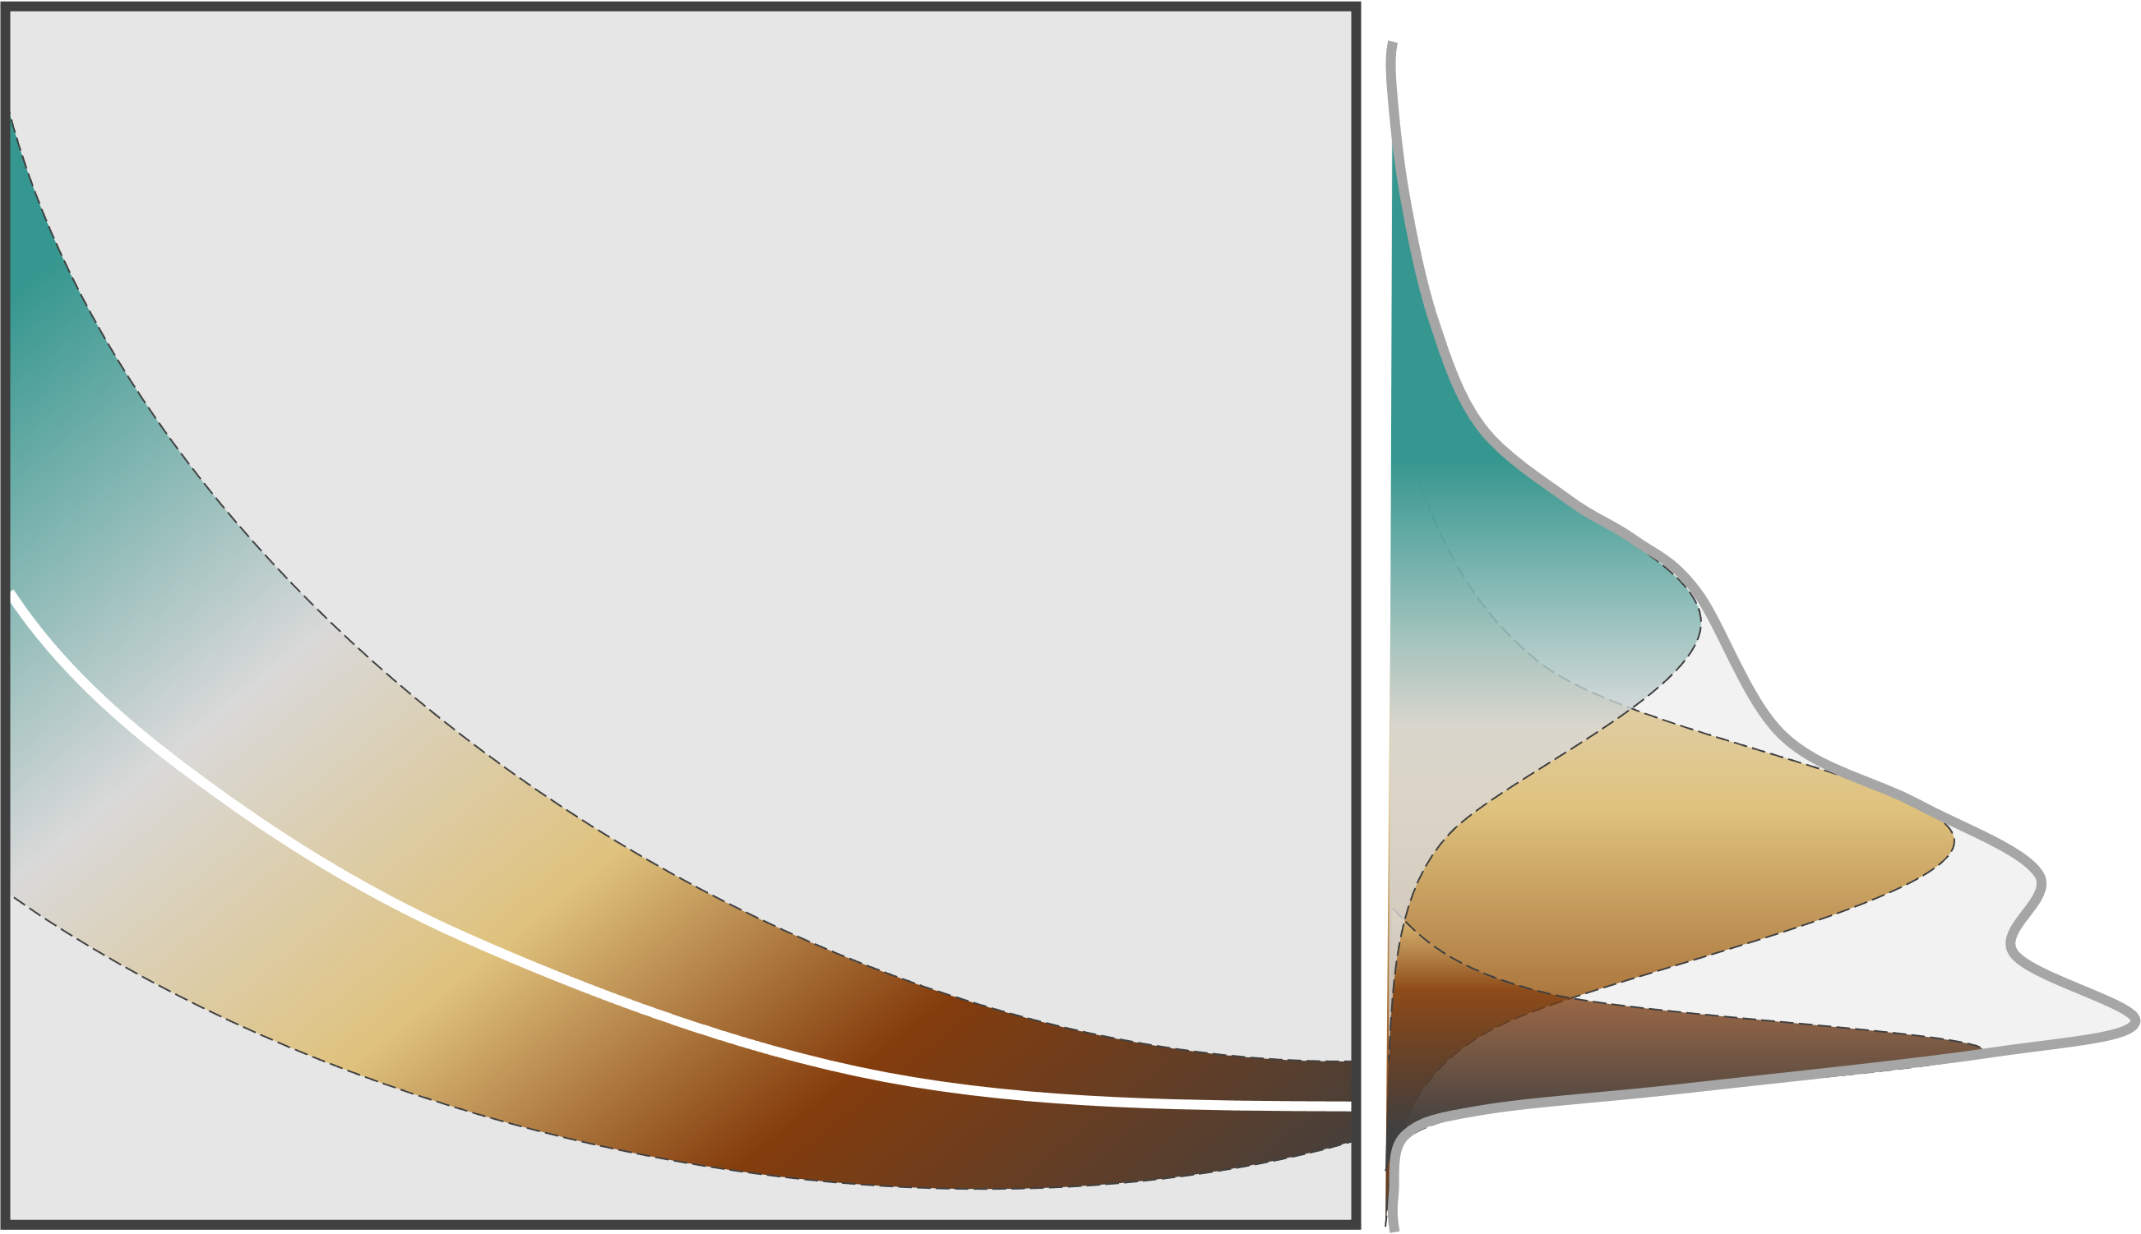

Slide 35
Notes:
Notice that we cannot make direct inferences about the potential sub-populations but about the overall distribution, whose shape, under the beta distribution, assumes the superposition of different subpopulations.

Slide 41


